Slide 1
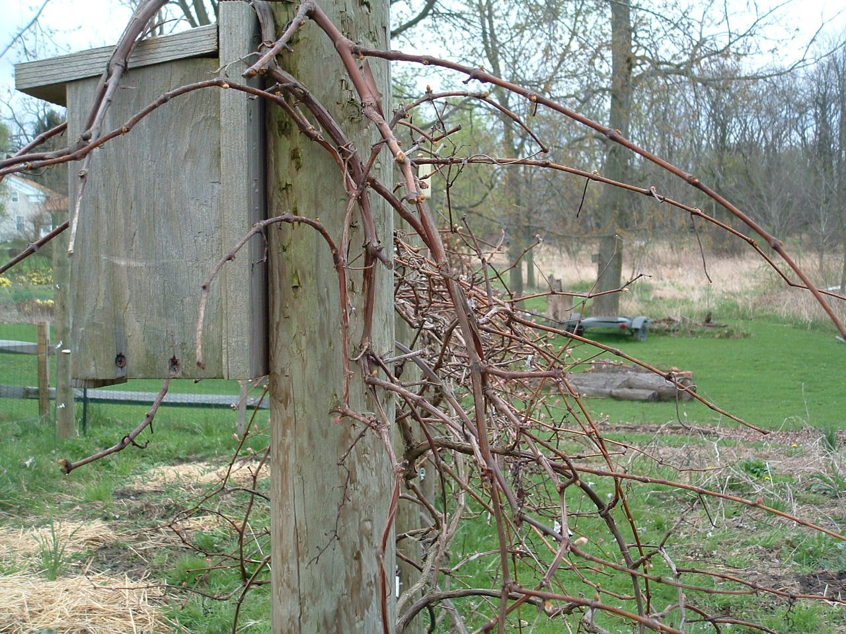
“Wood of the Vine”
Ezekiel 15
Notes:
Text in Ezekiel dealing with the rebellion of Judah, warning them of upcoming judgment at the hands of the Babylonians
Judah’s sin was persistent rebellion (as seen in the text)
READ Chapter
Wood of the vine/contrasts with a vine bearing fruit (will note in a few minutes)
Some wood (cut from a tree), is useful
(vs. 3) – Objects made (furniture, etc.); Even a simple peg to hold a vessel
Wood of the vine useless except to be burned!
Judah compared to the wood of the vine. Useless because of her unfaithfulness (8)
God would “give up” the inhabitants of Jerusalem (to Babylon) (6)
God is acknowledged finally in judgment! (7)

Slide 2
Applications…
Like Judah, we are worthless if we are not bearing fruit for the Master (John 15:1-8)
~ Judah was “unfaithful” (Ezekiel 15:8)
~ If we are “unfruitful” for any reason we
are worthless to God
Like Judah, being worthless brings God’s judgment! (2 Peter 2:18-22)
Like Judah, God’s judgment will clearly show us that HE is God! (2 Cor. 5:9-11)

Slide 3
Conclusion
In the judgment, every knee will bow down and confess God. It would be better for us to acknowledge Him now, and live in such a way as to be of value to Him!
“Be diligent to present yourself approved to God, a worker who does not need to be ashamed, rightly dividing the word of truth.”
(2 Timothy 2:15)

